Slide 1

Impact of Weather on Autonomous Vehicle Safety:
A Risk Assessment Approach
Presented By: Johora Akter Polin

Slide 2
Outline
Background
Motivation
Takeaways
Related works & Challenges
Research Methodology
Future Work
Conclusion
References

Slide 3
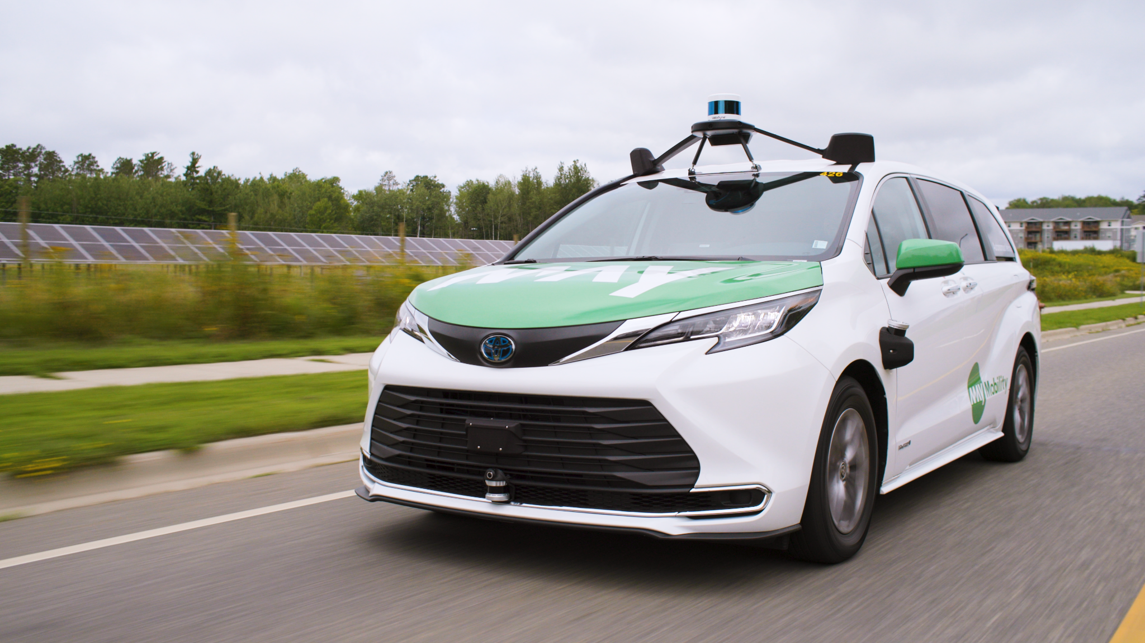
Background
Self driving Car
Initially Conceptualized 20th Century

Slide 4
Now

Slide 5
After 10 years….

Slide 6
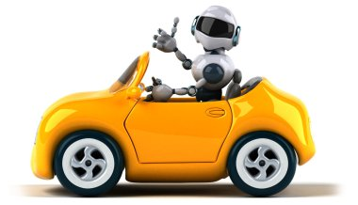
Background
Safety & Security
Performance And Efficiency
Fully Automated
Save Money

Slide 7
Autonomous Vehicle Accidents in Adverse Weather (2015-2024) [1,2]
Incident Type | Weather | Accident | Severity (Minor, Major, Fatal)
Pedestrian Detection Failures | Rain | 30% | 75% Minor, 20% Major, 5% Fatal
Vehicle Detection Failures | Fog | 25% | 60% Minor, 35% Major, 5% Fatal
Traffic Sign Detection Failures | Snow | 15% | 80% Minor, 15% Major, 5% Fatal
Unexpected Object Recognition | Heavy Rain/Fog Mix | 20% | 70% Minor, 25% Major, 5% Fatal
False Positives/Negatives | Rain/Snow/Fog Combined | 10% | 90% Minor, 10% Major

Slide 8
Motivation
Safety
Safety analysis
Performance
Performance Analysis

Slide 9
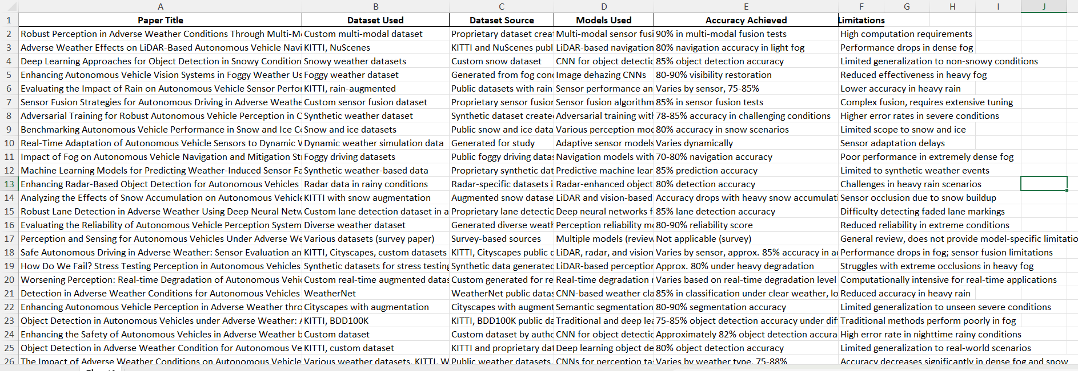
Related Works

Slide 10

Research Gap & Challenges
Dataset
Limited amount of Data and combination of weather
Object Consideration
Potholes are often overlooked
Model
Used several old version of object detection technique

Slide 11

Takeaways
Performance Degradation in Extreme Conditions: While many models perform well in moderate adverse weather, extreme conditions such as dense fog or heavy rain cause significant performance drops.
Importance of Risk Assessment Models: Effective risk assessment models that integrate weather forecasting significantly enhance safety.
Balancing Safety and Scalability: Achieving a balance between model safety, computational efficiency, and scalability

Slide 12

Research Questions
RQ1: Which type of adverse weather- such as heavy rain, snow, and fog causes the most significant impact on camera-based object detection?

Slide 13
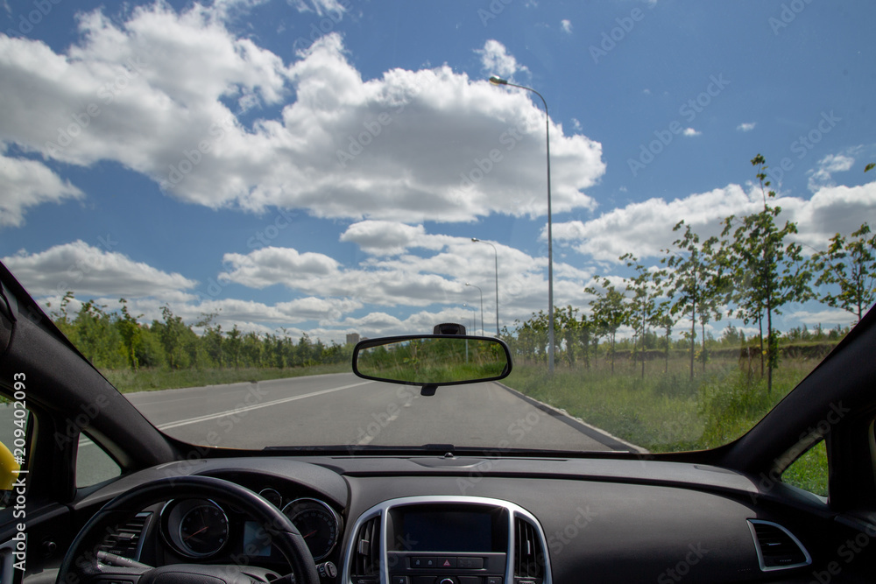
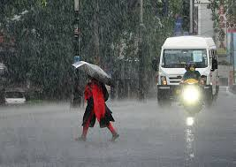
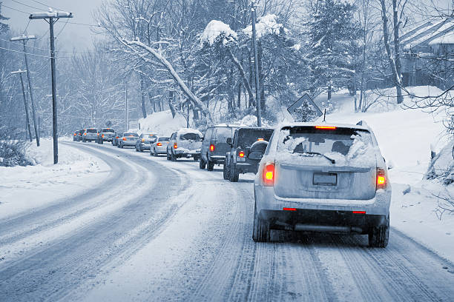
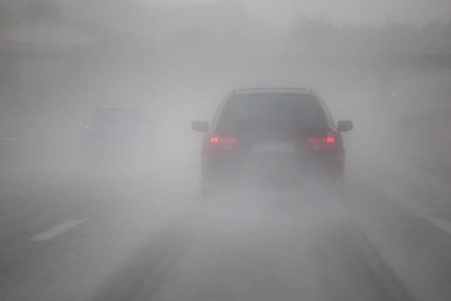
Dataset Analysis (1)
Normal
Rain
D
Snow
Fog

Slide 14
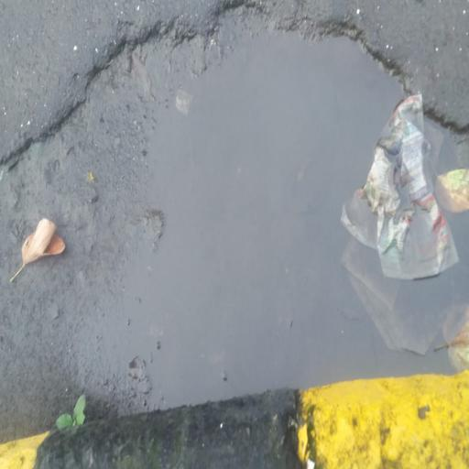
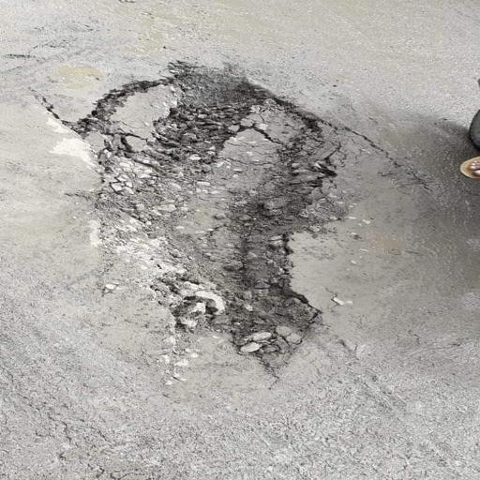
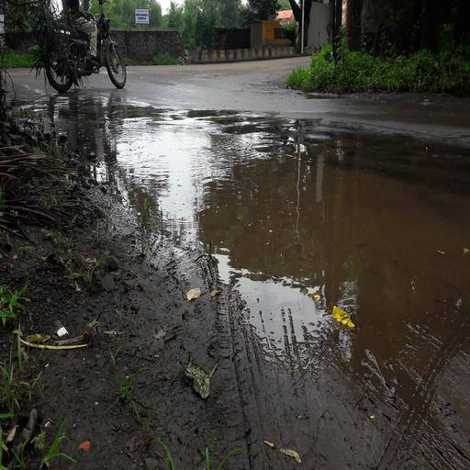
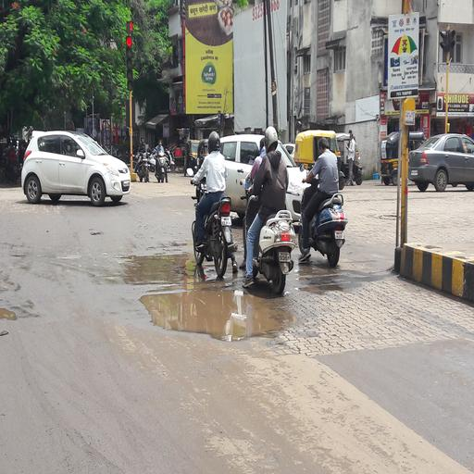
Dataset Analysis (2)
BDD100K
Kaggle

Slide 15




Considered Objects

Slide 16
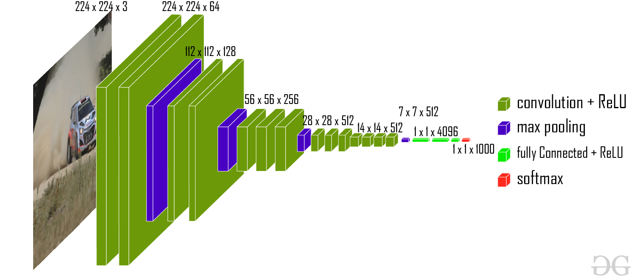
Proposed Methodology
CNN Model
Figure: CNN Model

Slide 17

YOLO v8
Figure: Yolo v8 architecture

Slide 18
Result Analysis
Result using CNN
 | Sunny | Rainy | Foggy | Snowy
Pedestrian | 89% | 79 % | 79.5 % | 80 %
Bus | 88% | 80% | 81% | 80 %
Car | 94 % | 81 % | 84% | 81 %
Traffic Sign | 86 % | 77% | 80% | 78 %

Slide 19
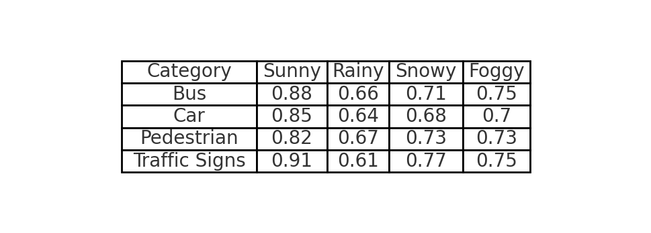
Result Analysis: CNN Model

Slide 20
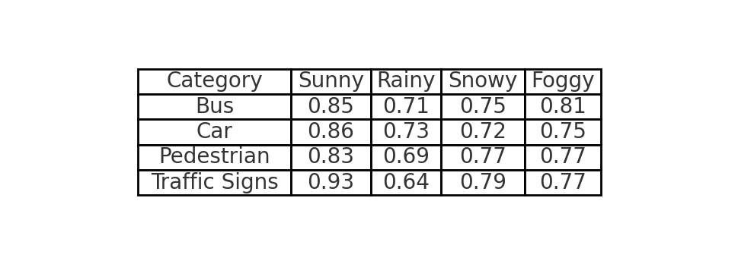
Result Analysis: YOLOv8 Model

Slide 21
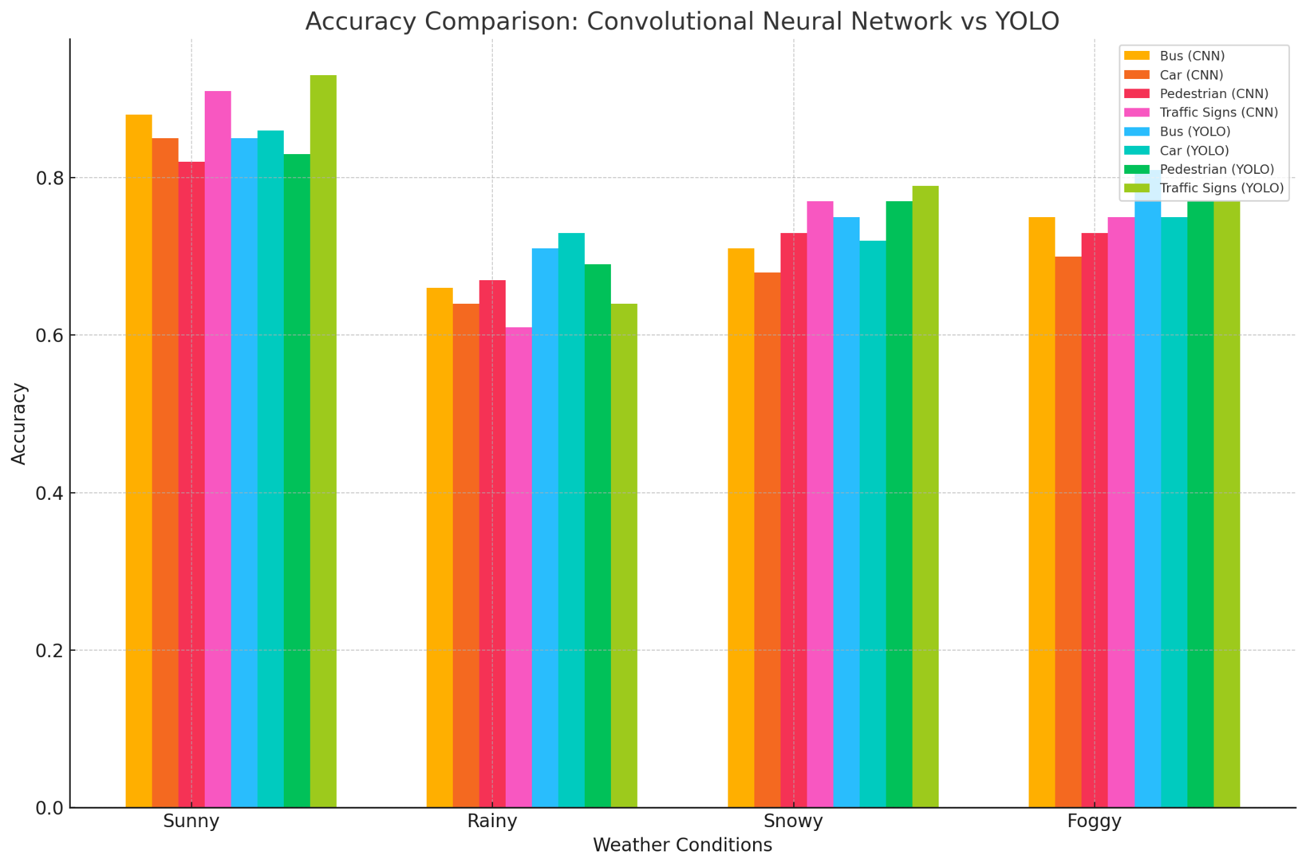
Graph: Comparison between Models

Slide 22

Evaluation Metrics
Accuracy, True Positives + True Negatives
Precision,
Recall,
F1-score,
Total Samples
True Positives
True Positives + False Positives
True Positives
True Positives + False Negatives
Precision x Recall
2 x
Precision + Recall

Slide 23

Testbed
 | NVIDIA GPU Workstation
CPU | 15 vCPU AMD EPYC 7543 32-Core
GPU | 2 * 24GB GeForce RTX 3090
Frequency | 2.8 GHz
Core | 15
Memory | 80 GB
OS | Ubuntu

Slide 24
Milestone
1.
Background Review
8.
Future Work
2
Data Collection
7.
Documentation
3.
Data Pre-processing
6.
Conclusion
4.
Experiment
5.
Result Analysis

Slide 25
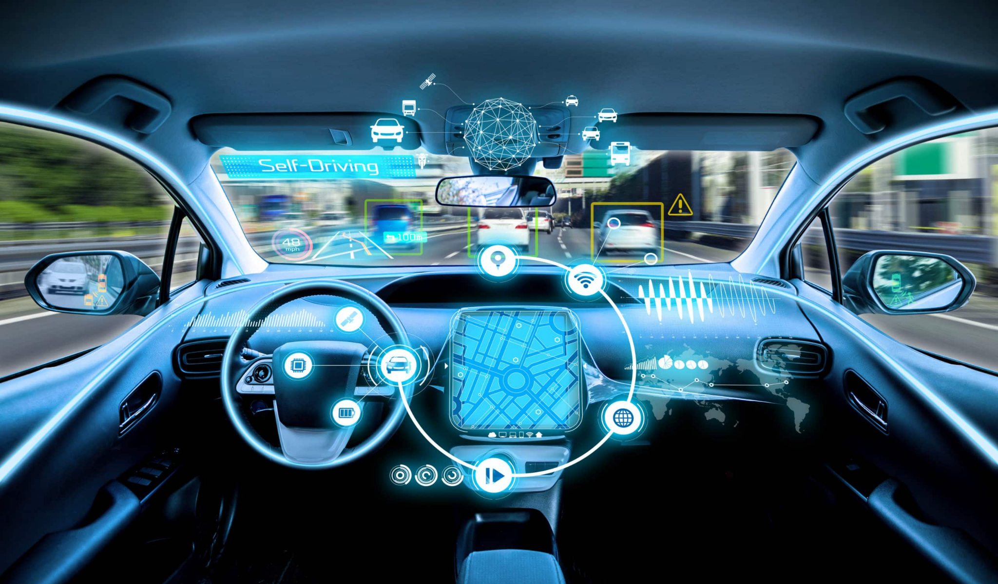
Future Work
Combining lane Detection
More Dataset Integration
Advance Model for Evaluation

Slide 26

Conclusion
Addressing the challenges of adverse weather on autonomous vehicle safety requires diverse datasets. Optimizing computational efficiency and real-time performance is critical for resilience in extreme conditions, ensuring AVs can operate safely and reliably across diverse, unpredictable environments.

Slide 27
Reference
https://www.nhtsa.gov/
https://www.vis.xyz/bdd100k/
https://robotcar-dataset.robots.ox.ac.uk/
https://www.freepik.com/
https://chatgpt.com/c/672187f5-9670-8011-97cf-efe7ba00d840
https://docs.google.com/spreadsheets/d/1MDZEz-BvcQMdAdzlA5wfL-HY1f8Kdn9p/edit?usp=sharing&ouid=106996604554018179736&rtpof=true&sd=true

Slide 28


